Slide 1

Delivering Perishable Information and Cargos: Delay-Constrained Communication and Transportation
Lei Deng
Supervisor: Prof. Minghua Chen
April 11, 2017
Department of Information Engineering The Chinese University of Hong Kong

Slide 2
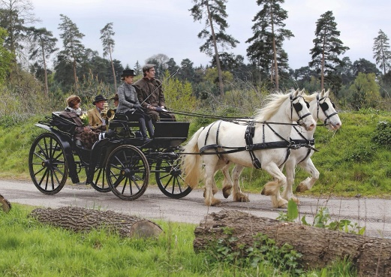
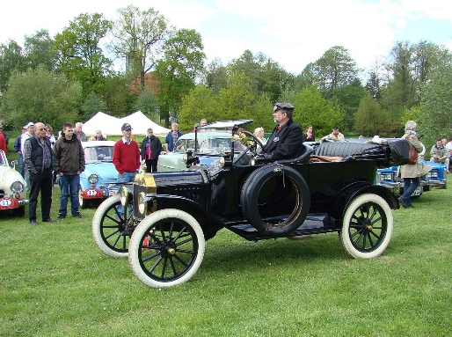
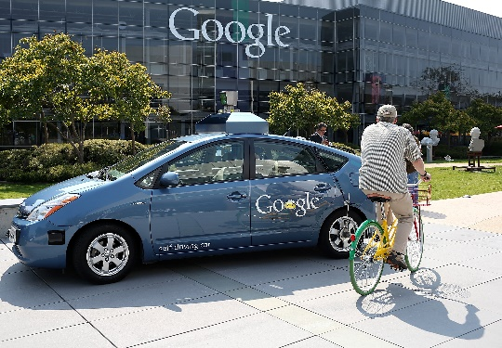
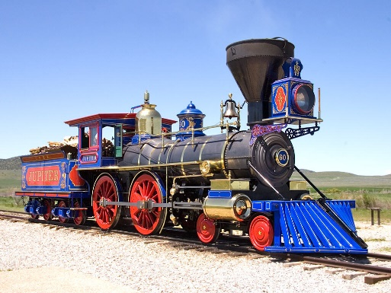
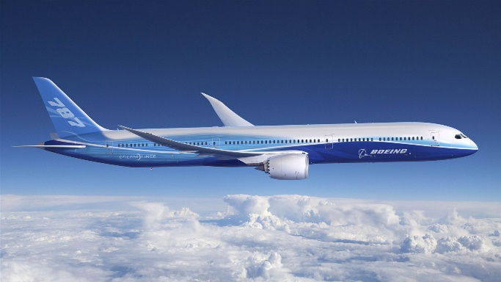
Transportation System Evolution
Horse-drawn vehicle
Modern car
Autonomous car
2000 BC
1804
1886
1903
Future
Steam locomotive
Airplane
Notes:
1 Horse-drawn vehicle
2 Steam locomotive
3 Modern Car
4 Airpalne
5 Autonomous car

Slide 3
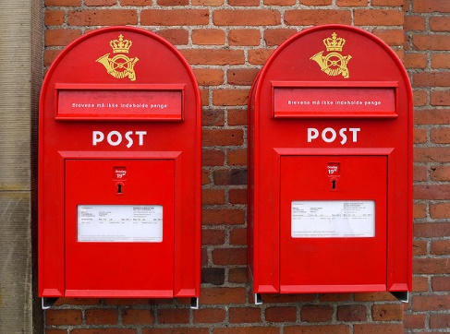





Communication System Evolution
Postal System
Telephone
Cellphone
Smartphone
2400 BC
1792
1876
1969
1973
2007
Telegraphy
Internet
Notes:
1 Horse-drawn vehicle
2 Steam locomotive
3 Modern Car
4
5 Autonomous car

Slide 4
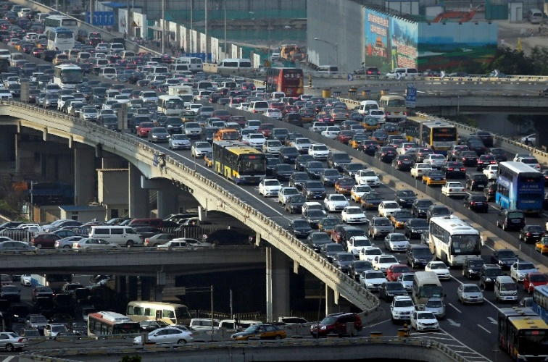

Thought Sophisticated, Current Transportation and Communication Systems Are Best-Effort
Users could experience unexpected long delay
It is important to provision delay-constrained services
It remains largely open to extend existing solutions to the delay-constrained scenarios

Slide 5
Our Attempt Towards Provisioning Delay-Constrained Services
Delay-Constrained Transportation
Energy-efficient timely transportation of long-haul heavy-duty trucks
Delay-Constrained Communications
Timely wireless flow with general traffic patterns: capacity region and scheduling algorithms

Slide 6
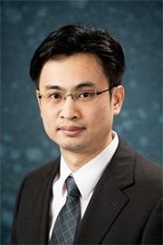

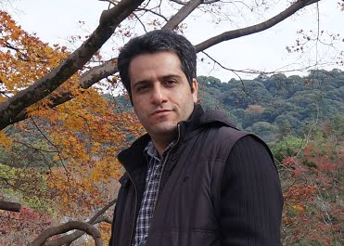
Energy-efficient Timely Transportation of Long-haul Heavy-duty Trucks
Lei Deng, Mohammad H. Hajiesmaili, Minghua Chen, and Haibo Zeng,
“Energy-Efficient Timely Transportation of Long-Haul Heavy-Duty Trucks,”
in Proc. ACM e-Energy, June 2016. (Best Paper Candidate)
(under review in IEEE Transactions on Intelligent Transportation Systems (TITS))

Slide 7
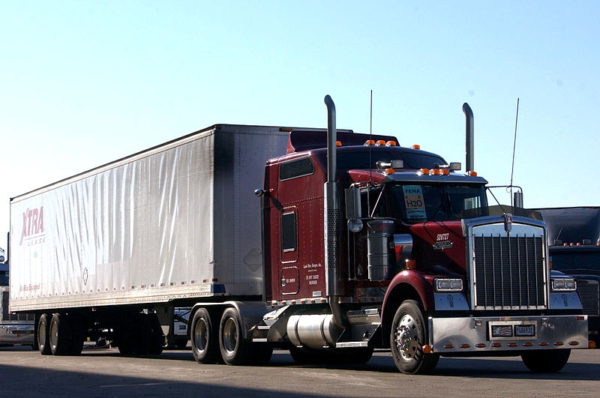
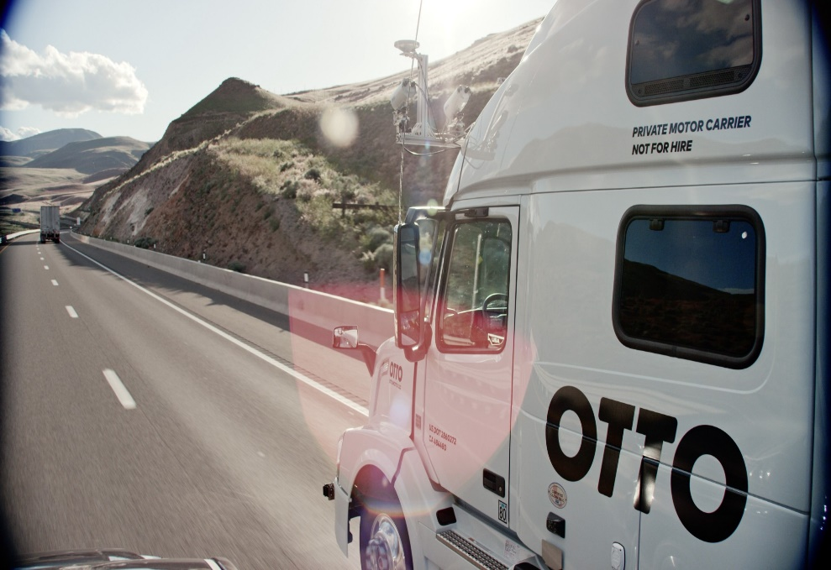
Heavy-Duty Trucks
A typical tractor-trailer truck today,
also known as an "18-wheeler"
(Source: Wikipedia)
An autonomous truck tomorrow
(Source: Otto; A start-up founded by Google engineers and acquired by Uber; ranked 2nd in the 10 Breakthrough Technologies in 2017 by MIT Technology Review)
Notes:
established in January 2016, then acquired by Uber at $680M in August 2016

Slide 8
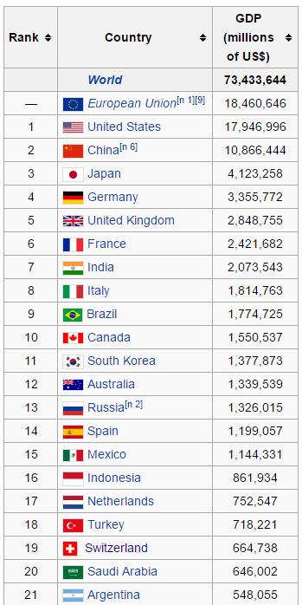
US Trucking Industry: A Top-20 Economy
Freight revenue¹: $726B in 2015 (2.3x of Hong Kong GDP)
Freight tonnage¹: 10B (70% of all freight), 2015
Number of heavy-duty truck drivers²: 1.8M, 2014
Source 1: ATA American Trucking Trends 2016
Source 2: Bureau of Labor Statistics,
U.S. Department of Labor
GDP Rank 2015, Source: Wikipedia

Slide 9
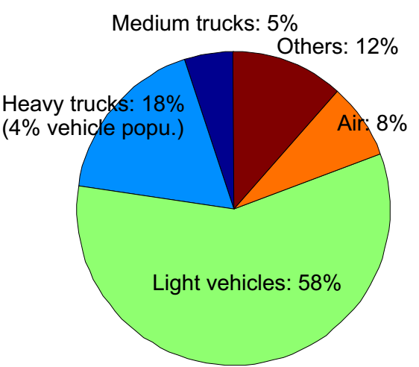
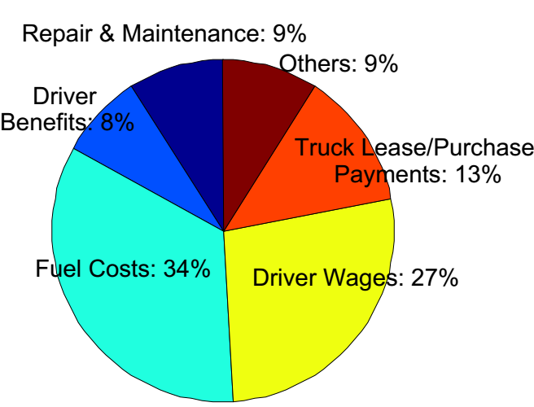
Greening Heavy-Duty Trucks Is Relevant
Transportation energy use (US 2013, source: US DOE)
Operational costs of trucking (US 2014, source: American Transportation Research Institute)
Notes:
On one hand they are power hungry
On the other hand they are a major cost factor
2013 US transportation energy use (http://cta.ornl.gov/data/tedb34/Edition34_Full_Doc.pdf):
Total: 26,153.4 Trillion Btu
Heavy-duty trucks: 4,613 Trillion Btu
How many Btu in 1 gallon of automotive gasoline? The answer is 124884.378164 Btu. http://www.convertunits.com/from/Btu/to/gallon
Then 26,153.4 Trillion Btu = 26,153.4*1000 /124884 Billion gallons = 209 Billion gallons
4,613 Trillion Btu = 4,613 *1000 /124884 Billion gallons = 37 Billion gallons
U.S. Regular Gasoline Prices* (dollars per gallon) https://www.eia.gov/petroleum/gasdiesel/
2017 April 03: 2.360 dollars per gallon
Thus total transportation sector: 26,153.4 Trillion Btu= 209 Billion gallons = 493 Billion dollars
Heavy-duty truck: 4,613 Trillion Btu = 37 Billion gallons = 87 Billion dollars

Slide 10
How to Reduce Fuel Consumption?
Fuel-economic truck design
Designs better engines, drivetrains, aerodynamics and tires, etc. Example: SuperTruck
Energy-efficient truck operation
Route planning
Speed planning
Platoon more than one trucks
etc

Slide 11
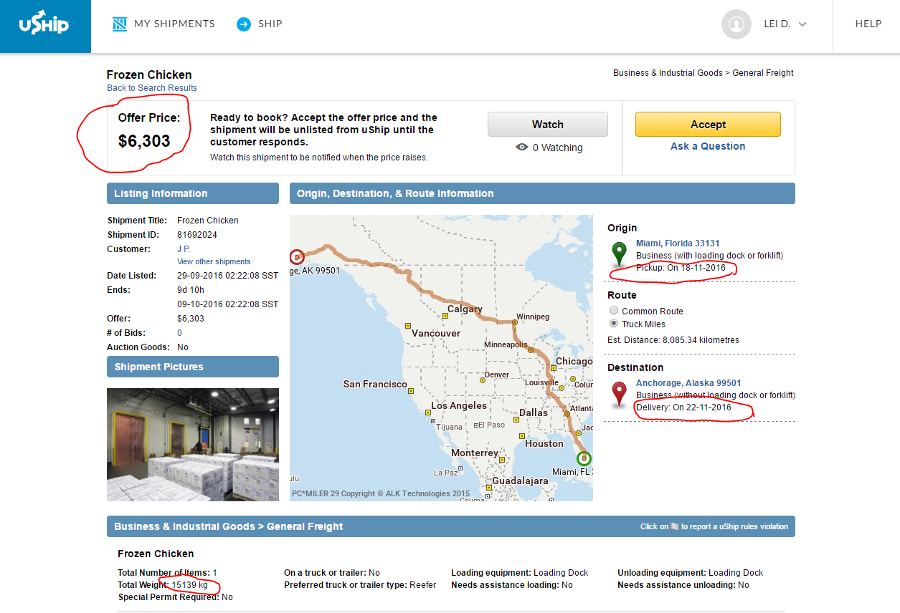
Truck Operation: Timely Transportation
As estimated by US FHWA, unexpected delay can increase freight cost by 50% to 250%
Notes:
FHWA – federal highway administration

Slide 12
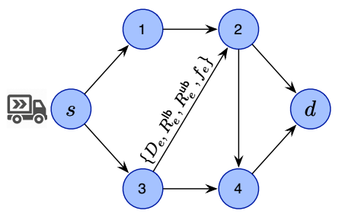
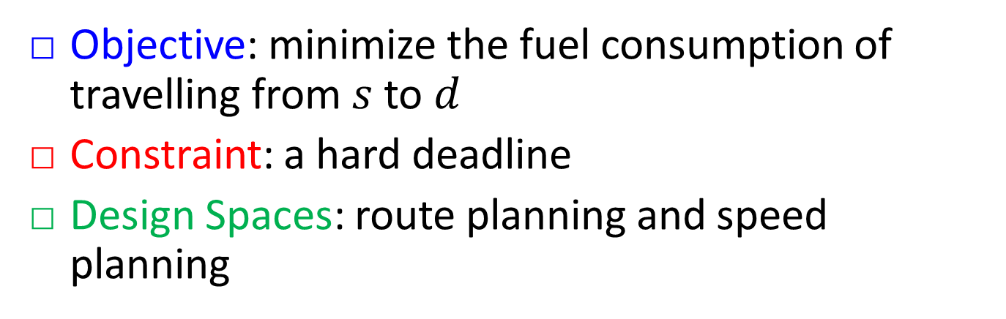
Energy-Efficient Timely Transportation
Objective: minimize the fuel consumption of travelling from $s$ to $d$
Constraint: a hard deadline
Design Spaces: route planning and speed planning

Slide 13
Research Landscape
Paper | Hard Deadline | Route Planning | Speed Planning
[1][2][3] | ✗ | ✓ | ✗
[4][5] | ✗ | ✗ | ✓
[6] | ✓ | ✗ | ✓
Current Practice | human intelligence
This Work | ✓ | ✓ | ✓
[1] Eva Ericsson, et al, Optimizing route choice for lowest fuel consumption – Potential effects of a new driver support tool, Transportation Research Part C, 2006.
[2] K. Boriboonsomsin, et al, Eco-routing navigation system based on multisource historical and real-time traffic information, IEEE Transactions on Intelligent Transportation Systems, 2012.
[3] G. Scora, et al, Value of eco-friendly route choice for heavy-duty trucks, Research in Transportation Economics, 2015.
[4] M. Voort, M. Dougherty, and M. Maarseveen. "A prototype fuel-efficiency support tool." Transportation Research Part C: Emerging Technologies, 2001.
[5] E. Hellstrom, et al, Look-ahead control for heavy trucks to minimize trip time and fuel consumption, Control Engineering Practice, 2009.
[6] E. Hellstrom, et al, Design of an efficient algorithm for fuel-optimal look-ahead control, Control Engineering Practice, 2010.
Notes:
[1] Route planning to save cost for a urban street environment, considering real-time traffic information collected by the probe vehicle, and the vehicle can only follow the real-time traffic flow.
[2] Route planning to save cost for freeway-only networks, when the vehicle uses the historical average speed.
[3] Route planning to save cost for heavy-duty trucks, where the vehicle uses the predicted real-time speed based on the historical data.
[4] A system prototype to give suggestions to the vehicle drivers about the driving habits, e.g., when to change gear and when to accelerate, etc.
[5] Speed planning so as to minimize the weight sum of fuel consumption and trip time. The running speed is within a speed interval. The route is given.
[6] Speed planning by using the gear shifting so as to minimize the fuel consumption while satisfying a hard deadline. The route is given.

Slide 14
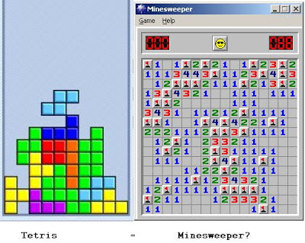



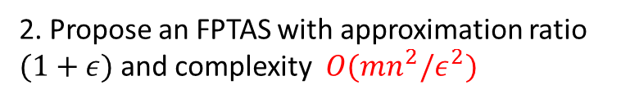
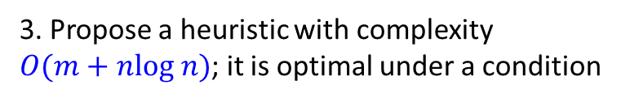
Our Contributions
4. Show up to 17% fuel saving, as compared to fastest/shortest path algorithm, in simulations using US highway data
1. Show Energy-efficient timely transportation is NP-Complete
3. Propose a heuristic with complexity $O(m+nlog n)$; it is optimal under a condition
2. Propose an FPTAS with approximation ratio $(1+ε)$and complexity $O(mn^{2}/ε^{2})$
$m$ is the number of edges, $n$ is the number of nodes
Notes:
Richard Kaye, a lecture in Pure Mathematics, The University of Birmingham, prove that the minesweeper game is NP-Complete, in 2000.
Tetris is also NP-Complete: Erik D. Demaine, Susan Hohenberger, David Liben-Nowell, https://arxiv.org/abs/cs/0210020, 2002.
fully polynomial-time approximation scheme or FPTAS, which requires the algorithm to be polynomial in both the problem size n and 1/ε

Slide 15
A Simple Demo

Slide 16
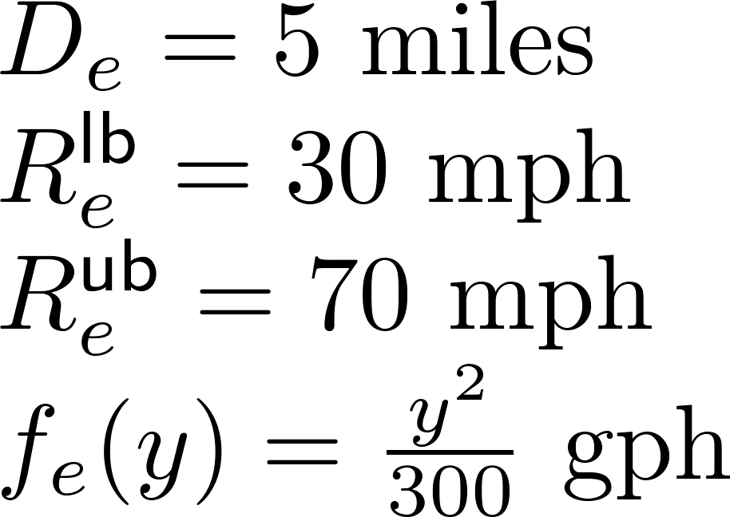
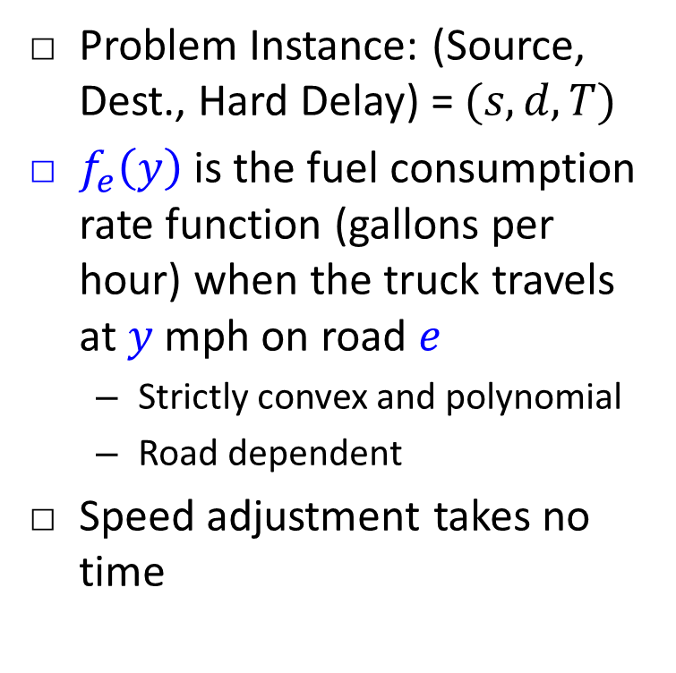
System Model
Problem Instance: (Source, Dest., Hard Delay) = $(s,d,T)$
$f_{e}\left(y\right)$ is the fuel consumption rate function (gallons per hour) when the truck travels at $y$ mph on road $e$
Strictly convex and polynomial
Road dependent
Speed adjustment takes no time
Example:
Notes:
Explain D_e R_e^{lb}, R_e^{ub}

Slide 17
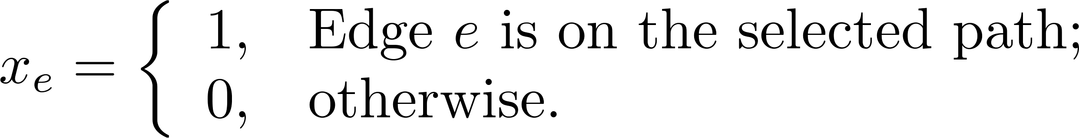
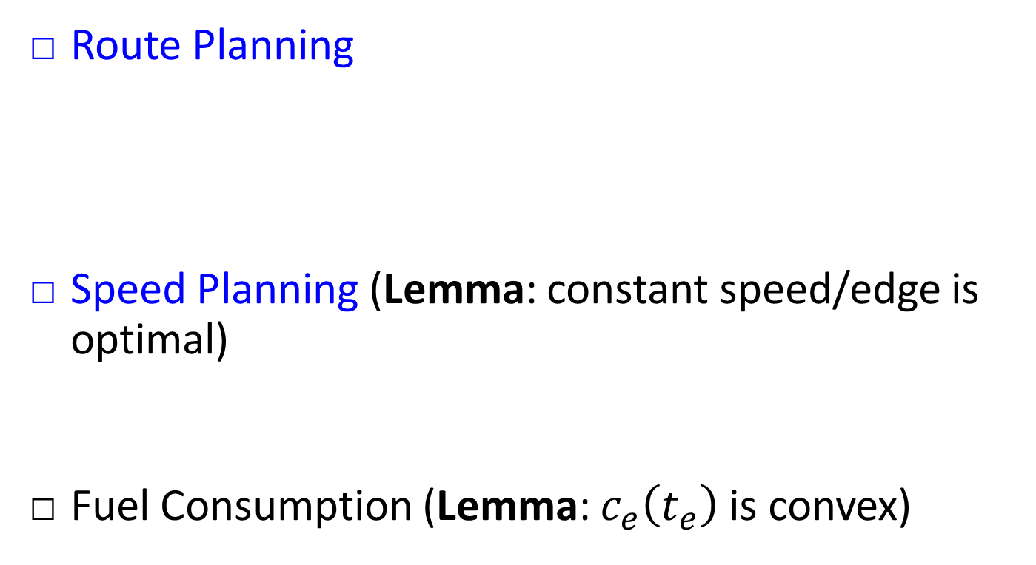
Design Space and Simplification
Route Planning
Speed Planning (Lemma: constant speed/edge is optimal)
Fuel Consumption (Lemma: $c_{e}\left(t_{e}\right)$ is convex)
Travel-time Speed Fuel-Consumption-Rate Fuel-Consumption

Slide 18
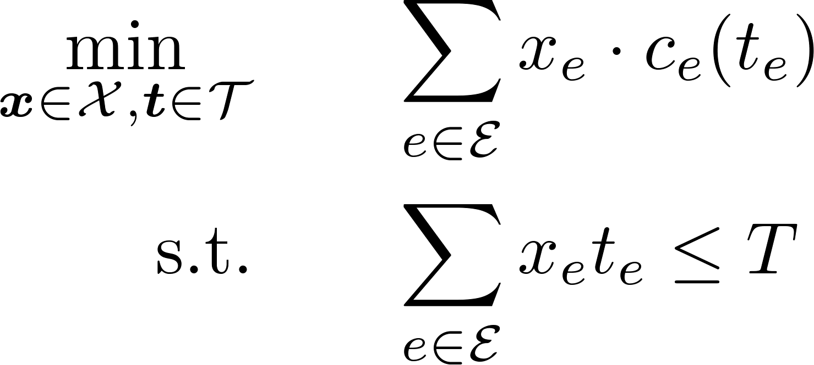
Problem Formulation
PAth Selection and Speed Optimization (PASO)
Mixed discrete-continuous optimization
Non-linear non-convex constraint and objective

Slide 19
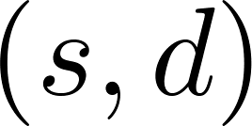
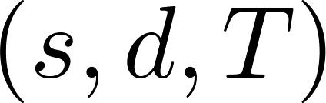
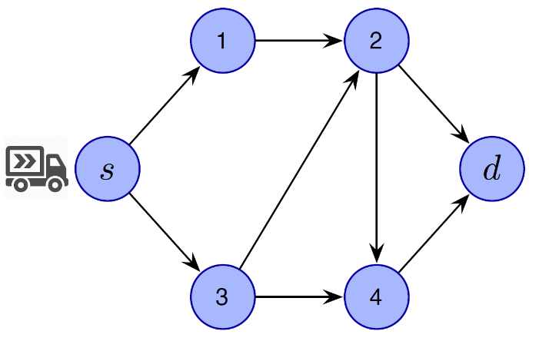
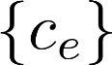
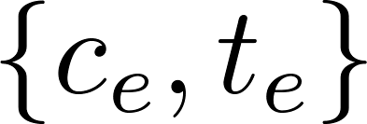
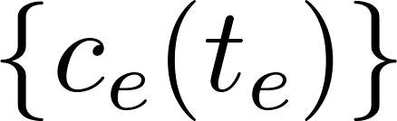
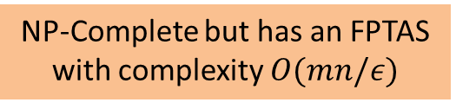
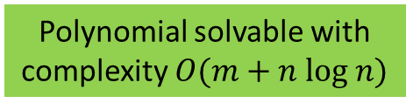
Compare PASO and Existing Problems
Shortest-Path (SP)
No travel time
Fixed travel cost
No deadline
Route planning
Restricted-Shortest-Path (RSP)
Fixed travel time
Fixed travel cost
Hard deadline
Route planning
PASO
Variable travel time
Variable travel cost
Hard deadline
Route planning
Speed planning
Polynomial solvable with complexity $O(m+n log n)$
NP-Complete but has an FPTAS with complexity $O(mn/ε)$
?
Notes:
Add a shortest path example as well
Polynomial time solvable → NP-Complete

Slide 20
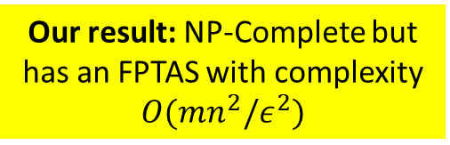
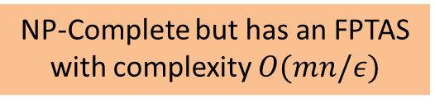
Compare PASO and Existing Problems
Shortest-Path (SP)
No travel time
Fixed travel cost
No deadline
Route planning
Restricted-Shortest-Path (RSP)
Fixed travel time
Fixed travel cost
Hard deadline
Route planning
PASO
Variable travel time
Variable travel cost
Hard deadline
Route planning
Speed planning
Polynomial solvable with complexity $O(m+n log n)$
NP-Complete but has an FPTAS with complexity $O(mn/ε)$
Our result: NP-Complete but has an FPTAS with complexity $O(mn^{2}/ε^{2})$
Notes:
Add a shortest path example as well
Polynomial time solvable → NP-Complete

Slide 21
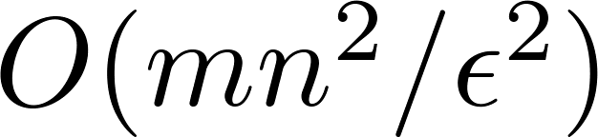
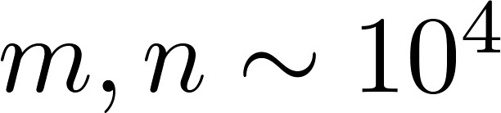
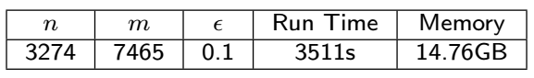
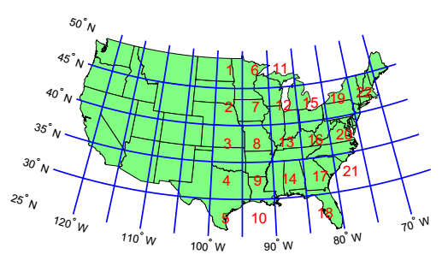
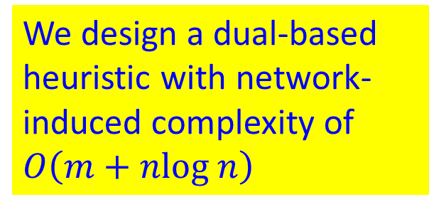
FPTAS Suffers from Excessive Running Time and Memory Usage
Network-induced time complexity is
In practical highway networks,
Consider regions 17&18
We design a dual-based heuristic with network-induced complexity of $O\left(m+nlog n\right)$

Slide 22
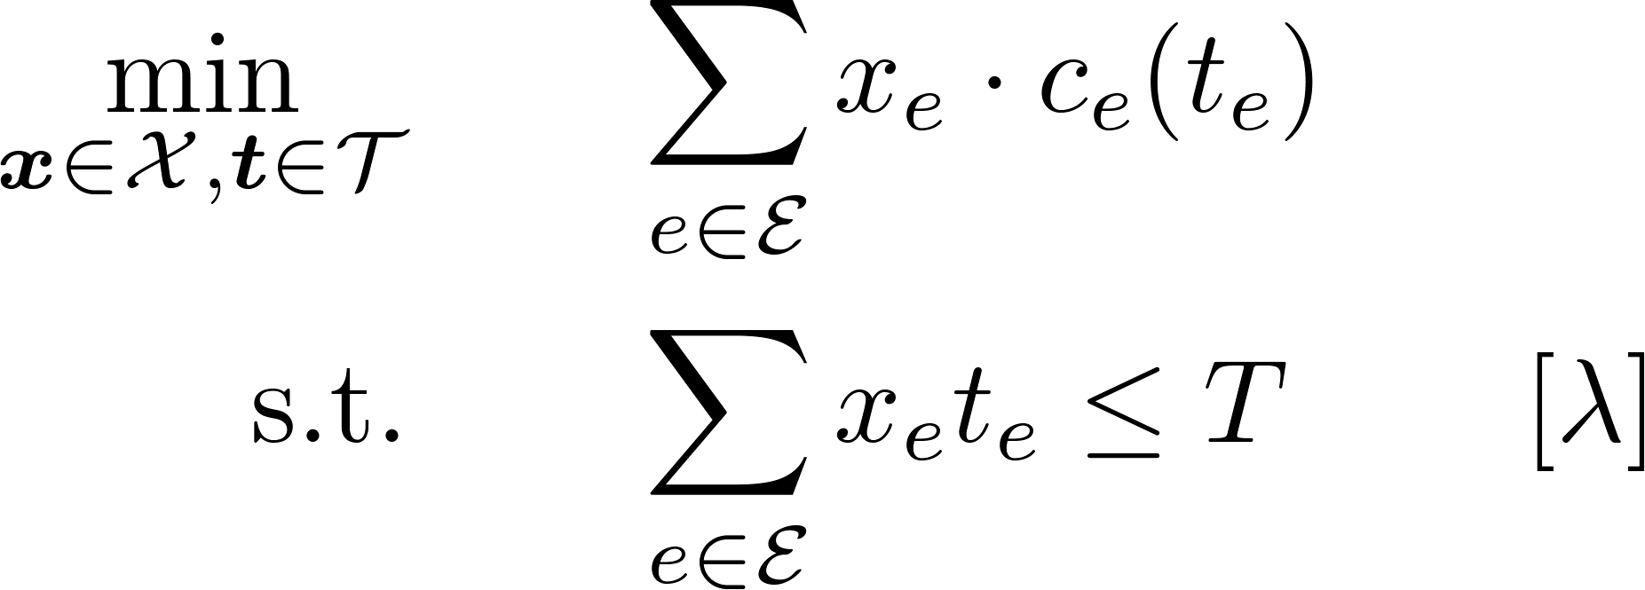
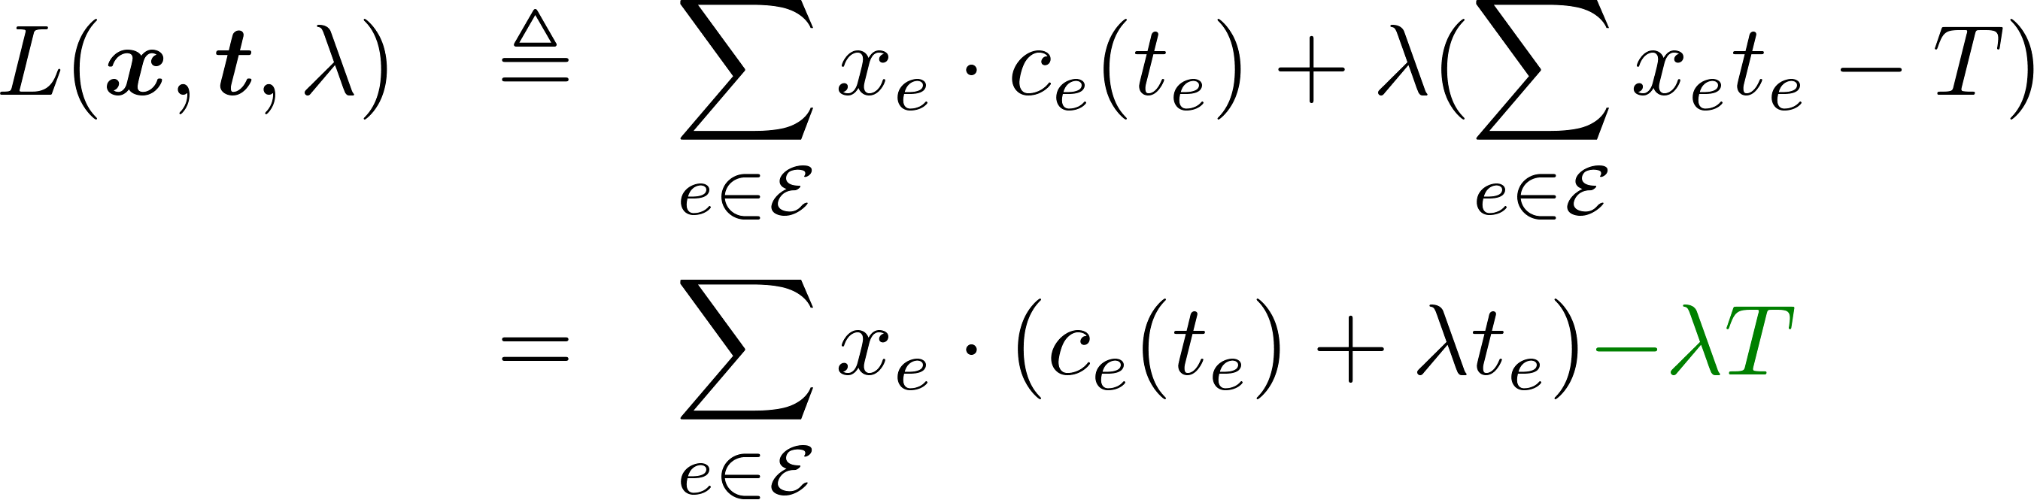
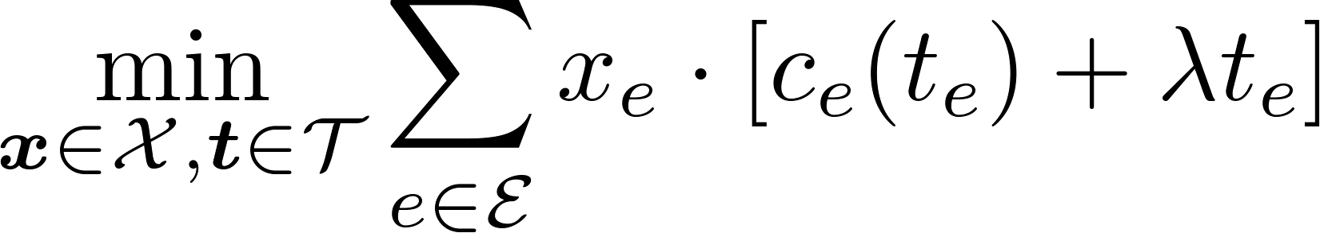

Make the Problem Simpler
(PASO)
delay price
(PASO-Relax( ))

Slide 23
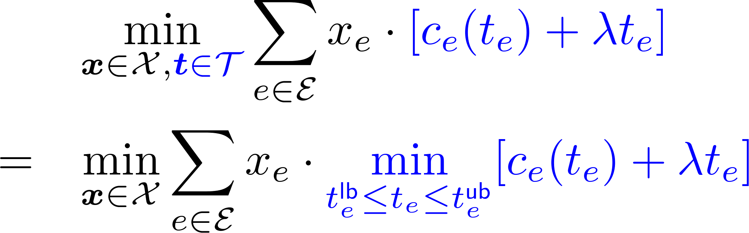
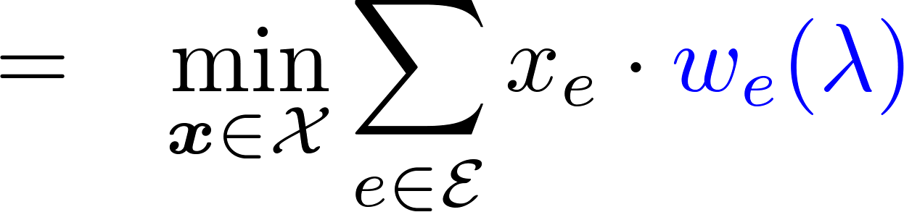
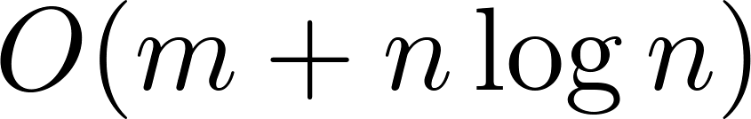
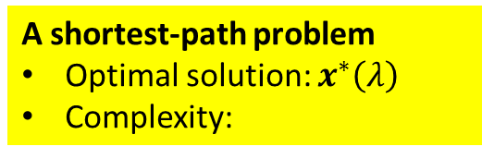
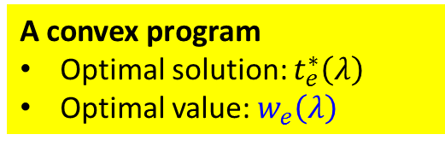


PASO-Relax($λ$) Is Easy to Solve
(PASO-Relax( $λ$ ))
A convex program
Optimal solution: $t_{e}^{∗}\left(λ\right)$
Optimal value: $w_{e}\left(λ\right)$
A shortest-path problem
Optimal solution: $x^{∗}\left(λ\right)$
Complexity:

Slide 24
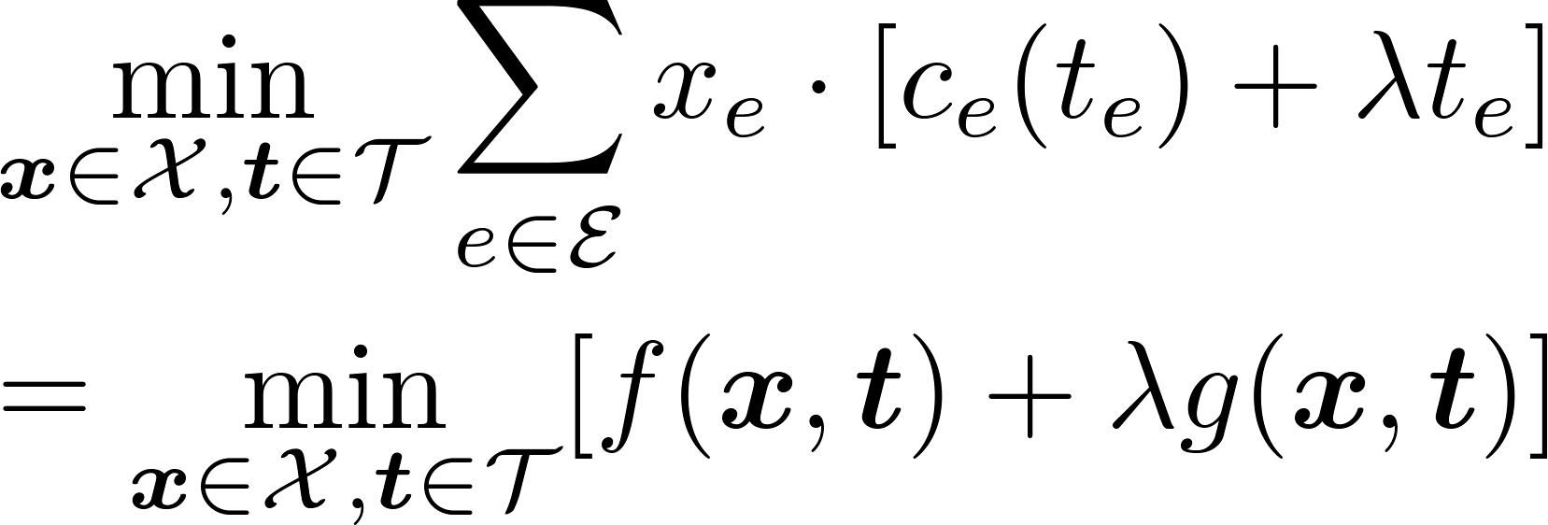
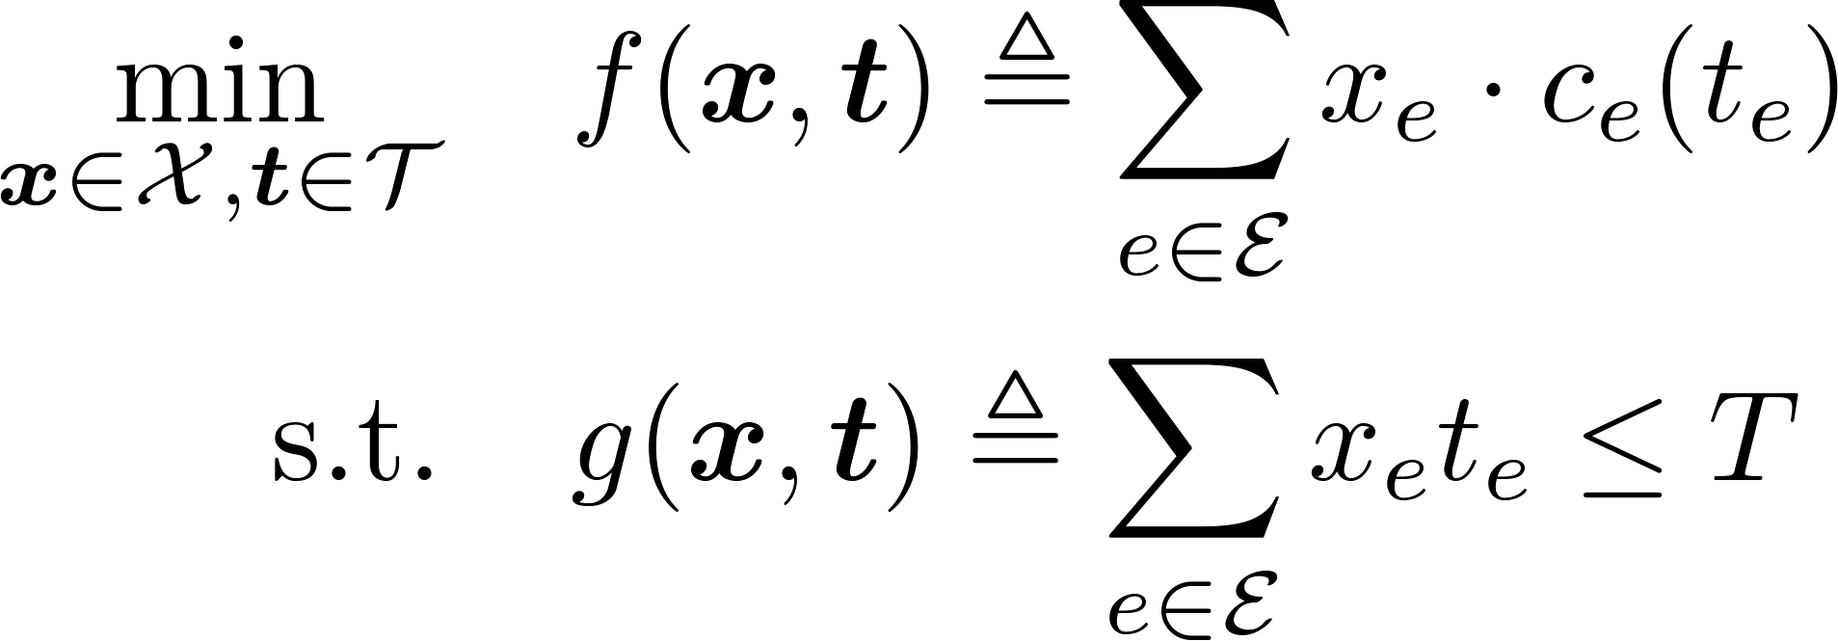





A Sufficient Condition for Optimality/Strong Duality
PASO: NP-Complete
PASO-Relax($λ$): Polynomial solvable
${(x}^{∗}\left(λ\right), t^{∗}\left(λ\right))$ is the optimal solution
Question 1: Does such a $λ_{0}$ always exist?
Question 2: If such a $λ_{0}$ exisits, how to find it?
Define
Theorem: If there exists a $λ_{0}$ such that (i) $λ_{0}=0$ and $δ\left(λ_{0}\right)≤T$, or (ii) $λ_{0}>0$ and $δ\left(λ_{0}\right)=T$, then ${(x}^{∗}\left(λ_{0}\right), t^{∗}\left(λ_{0}\right))$ is optimal to PASO, and strong duality holds
Intuitions for (ii): If $δ\left(λ_{0}\right)>T$, then ${(x}^{∗}\left(λ_{0}\right), t^{∗}\left(λ_{0}\right))$ is infeasible
If $δ\left(λ_{0}\right)<T$, then we still have some room to decrease the speed to save fuel cost, and thus ${(x}^{∗}\left(λ_{0}\right), t^{∗}\left(λ_{0}\right))$ may not be optimal
Optimality happens when $δ\left(λ_{0}\right)=T$

Slide 25


A Key Observation
PASO: NP-Complete
PASO-Relax($λ$): Polynomial solvable
${(x}^{∗}\left(λ\right), t^{∗}\left(λ\right))$ is the optimal solution
Theorem: $δ(λ)$ is non-increasing.
Intuition: larger delay price $λ$
higher speed
➔ shorter (total) travel time $δ(λ)$

Slide 26

Our Heuristic
A Sufficient Condition for Optimality: If there exists a $λ_{0}≥0$ such that $δ\left(λ_{0}\right)=T$, then ${(x}^{∗}\left(λ_{0}\right), t^{∗}\left(λ_{0}\right))$ is optimal to PASO.
A Key Observation: $δ(λ)$ is non-increasing.
Heuristic: Binary search to find a $λ_{0}$such that $δ\left(λ_{0}\right)≲T$
Each step solves the relaxed problem PASO-Relax($λ_{0}$)
Stop when $λ_{0}(i)$ and $λ_{0}(i+1)$are close enough
Complexity: $O(\left(m+nlog n\right)\log{λ_{max}})$

Slide 27








Optimality Gap of the Heuristic
Heuristic: Binary search to find a $λ_{0}$such that $δ\left(λ_{0}\right)≲T$
If $δ\left(λ_{0}\right)=T$, then the output solution is optimal
If $δ\left(λ_{0}\right)<T$, then
Total fuel cost is $C_{1}$ and total delay is $T_{1}>T$
$$T$$
$$\left(T_{1}−T_{2}\right)$$
Total fuel cost is $C_{2}$ and total delay is $T_{2}<T$
Output solution of our heuristic
$$T$$
$λ_{0}\left(T_{1}−T_{2}\right)≈11.5∗0.2=2.3$, negligible to OPT $≈300$ gallons of fuel for a 40-hour trip
Theorem:

Slide 28

Our Dual-Based Heuristic Runs Fast
Algorithm | FPTAS | Dual-Based Heuristic
Complexity
Consider regions 17&18

Slide 29





How to Generalize Our Dual-Based Algorithm to Other Problems
easy to solve approx. for any
Question 1: Does such a $λ_{0}$ always exist?
Question 2: If such a $λ_{0}$ exisits, how to find it?
hard to solve approx.
$(\overline{x}\left(λ\right),\overline{t}(λ))$is an $α$–approx. solution
Theorem: If there exists a $λ_{0}$ such that
(i) $λ_{0}=0,g\left(\overline{x}\left(λ_{0}\right),\overline{t}\left(λ_{0}\right)\right)≤0$, or
(ii) $λ_{0}>0,g\left(\overline{x}\left(λ_{0}\right),\overline{t}\left(λ_{0}\right)\right)=0$,
then $(\overline{x}\left(λ_{0}\right),\overline{t}(λ_{0}))$is an $α$–approx. solution to (P).

Slide 30

Simulation: Network Statistics

Slide 31

Simulation: Heuristic vs. Baselines
Average performance of all 2700+ instances $(s,d,T)$
Fuel saving can power 70% of the transportation sector in New York State.
Energy consumption estimates by end-use sector, ranked by state, 2014. http://www.eia.gov/state/seds/data.cfm?incfile= /state/seds/sep sum/html/rank use.html&sid=US
Notes:
2704 instances
https://www.eia.gov/state/?sid=NY#tabs-2
New York transportation sector energy consumption in 2014: 1099 Trillion Btu
Heavy-duty trucks in 2013: 4,613 Trillion Btu
4613*16.37/1099=70%.

Slide 32

Conclusion and Future Work
Summary
Show the energy-efficient timely transportation problem in truck operation is NP-complete
An FPTAS with complexity $O({mn^{2}/ε}^{2})$
A heuristic algorithm with complexity $O\left(m+nlogn\right)$
Simulation shows up to 17% fuel consumption reduction as compared to the fastest/shortest path algorithm
As compared to the current ad-hoc solution, our algorithmic solution matches well for the future autonomous trucks
Future Work
Hours of Service (HOS) restriction
Rest area and waypoints
Future real-time traffic

Slide 33


Timely Wireless Flows with Arbitrary Traffic Patterns: Capacity Region and Scheduling Algorithms
Lei Deng, Chih-Chun Wang, Minghua Chen, and Shizhen Zhao, “Timely Wireless Flows with Arbitrary Traffic Patterns: Capacity Region and Scheduling Algorithms,” in Proc. IEEE INFOCOM, Apr. 2016.
(under second-round review in IEEE/ACM Transactions on Networking (ToN))

Slide 34

Delay-Constrained Wireless Communication
Real-time systems
Industrial control
Sensor networks
Real-time surveillance
+
Wireless Communications
Low cost
Low complexity
Easy to deploy
Real-time (Delay-Constrained) Wireless Communication

Slide 35

A Commonly Studied Network Scenario
Single-hop downlink AP scenario with K users
Time is slotted
Only one user can be
scheduled at any slot
Flow-k packet can be
delivered at one slot
with probability

Slide 36
Research Landscape and Our Contributions for the Single-hop Downlink AP scenario
 | Delay-Unconstrained | Delay-Constrained
Performance Metric | Throughput | Timely Throughput
Timely Traffic Pattern | N/A | Frame-Synchronized | General
Problem 1: Capacity Region | Tassiulas&Ephremides1993 | Hou&Borkar&Kumar2009 | Our Work
Problem 2: Network Utility Maximization (NUM) | Eryilmaz&Srikant2007 | Hou&Kumar2010 | Our Work
Problem 3: Feasibility-Optimal Policy Design | Tassiulas&Ephremides1993 | Hou&Borkar&Kumar2009 | Our Work
Notes:
[1] L. Tassiulas and A. Ephremides, “Dynamic server allocation to parallel queues with randomly varying connectivity,” IEEE Transactions on Information Theory, 1993.
(The arrival process are iid)
(Theorem 1 characterizes the capacity region with exponential number of linear constraints)
(LQF are optimal)
[2] A. Eryilmaz, and R. Srikant, “Fair Resource Allocation in Wireless Networks Using Queue-Length-Based Scheduling and Congestion Control”, IEEE/ACM Transactions On Networking, 2007.
(iid arrival but it said it is easy to generalize this assumption to allow dependence in the arrivals across time slots )
[3] X. Lin and N. Shroff, “Joint Rate Control and Scheduling in Multihop Wireless Networks”, in Proc. IEEE CDC, 2004.
[4] L. Tassiulas and A. Ephremides, “Stability properties of constrained queueing systems and scheduling policies for maximum throughput in multihop radio networks,” IEEE Transactions on Automatic Control, 1992.
[5] I. Hou, V. Borkar, and P.R. Kumar, “A Theory of QoS for Wireless,” in Proc. IEEE INFOCOM, 2009.
[6] I. Hou and P.R. Kumar, “Utility Maximization for Delay Constrained QoS in Wireless,” in Proc. IEEE INFOCOM, 2010.
[7] L. Deng, C. Wang, M. Chen, and S. Zhao, “Timely Wireless Flows with Arbitrary Traffic Patterns: Capacity Region and Scheduling Algorithms,” in Proc. IEEE INFOCOM, 2016.
In this talk, I will focus on the first two problems.
Note that supporting delay-constrained flows over multi-hop wireless networks can be addressed by extending our single-hop results, albeit high complexity.

Slide 37



General Traffic Pattern Model
Traffic pattern: periodic-iid with a hard delay
Flow 1
Frame-synchronized traffic pattern if all flows have the same parameters like flow 1
Flow 2

Slide 38


Problem Formulation
Performance metric: timely throughput
Two fundamental problems
Characterize Capacity Region
Design a Policy to Maximize Network Utility

Slide 39


An Example

Slide 40






Formulate As a MDP Problem
Observer the system state in terms of queue contents
The system state
evolves stochastically
Flow 2 gets a reward $p_{2}=0.8$ in slot 7
Make a decision: schedule which flow and which packet

Slide 41
The Unique Feature of our MDP Formulation
The MDP is cyclo-stationary!
The MDP is not stationary!
Existing Result: Stationary MDP
Randomized stationary polices are optimal
One-slot LP
Our Result: Cyclo-stationary MDP
Randomized cyclo-stationary (RAC) polices are optimal
T-slot LP

Slide 42
Significances
The T-slot LP characterizes the capacity region
NUM can be solved as a convex program with linear constraints
The optimal scheduling policy can be derived from the optimal solution

Slide 43

Drawback: Our MDP Suffers From the Curse of Dimensionality
Exponential number of states
Our solutions:
Propose a low-complexity heuristic algorithm, RAC-Approx, with complexity
Simulation results show that it achieves near-optimal performance

Slide 44
Compare Our MDP-based Approach and Hou&Kumar’s Idle-time-based Approach
 | Our MDP-based Approach | Idle-time-based Approach
Traffic Pattern | General | Frame-Synchronized
Complexity of Capacity Region | High | High
Complexity of Scheduling Policies | High | Low

Slide 45

Simulation: Capacity Region

Slide 46


Simulation: Network Utility Maximization

Slide 47
Conclusion and Future Work
Summary
Characterize timely capacity region for general traffic patterns for the first time
Propose a provably optimal scheduling policy to maximize the network utility
A heuristic to address the curse of dimensionality
Future Work
How to handle the curse of dimensionality with performance guarantee
Restless multi-armed bandit perspective

Slide 48
Overall Summary: Challenge and Opportunity
Challenge: the landscape of delay-constrained problems in the communication and transportation systems is completely different from those of the well-understood delay-unconstrained ones
Opportunity: many delay-unconstrained problems can be asked for the delay-constrained scenarios
Example: distributed solution design
We thus call for participant

Slide 49
Publications During My PhD Study
[J1] L. Deng, C. Wang, M. Chen, and S. Zhao, “Timely Wireless Flows with Arbitrary Traffic Patterns: Capacity Region and Scheduling Algorithms,” IEEE/ACM ToN, under review.
[J2] L. Deng, M. Hajiesmaili, M. Chen, and H. Zeng, “Energy-Efficient Timely Transportation of Long-Haul Heavy-Duty Trucks,” IEEE TITS, under review.
[J3] Y. Zhang, L. Deng, M. Chen, and P. Wang, “Joint Bidding and Geographical Load Balancing for Datacenters: Is Uncertainty a Blessing or a Curse?”, IEEE/ACM ToN, under review.
[J4] M. Hajiesmaili, L. Deng, M. Chen, and Z. Li, “Incentivizing Device-to-Device Load Balancing for Cellular Networks: An Online Auction Design,” IEEE JSAC, 2017.
[C1] L. Deng, M. Hajiesmaili, M. Chen, and H. Zeng, “Energy-Efficient Timely Transportation of Long-Haul Heavy-Duty Trucks,” ACM e-Energy, 2016. (Best Paper Candidate)
[C2] L. Deng, C. Wang, M. Chen, and S. Zhao, “Timely Wireless Flows with Arbitrary Traffic Patterns: Capacity Region and Scheduling Algorithms,” IEEE INFOCOM, 2016.
[C3] L. Deng, Y. Zhang, M. Chen, Z. Li, J. Lee, Y. Zhang, and L. Song, “Device-to-Device Load Balancing for Cellular Networks,” IEEE MASS, 2015.
[C4] Y. Zhang, L. Deng, M. Chen, and P. Wang, “Joint Bidding and Geographical Load Balancing for Datacenters: Is Uncertainty a Blessing or a Curse?”, IEEE INFOCOM, 2017.
[C5] P. Wang, Y. Zhang, L. Deng, M. Chen, and X. Liu, “Second Chance Works Out Better: Saving More for Data Center Operator in Open Energy Market,” CISS, 2016. (Invited Paper)

Slide 50
Awards During My PhD Study
Best Paper Award Candidate, ACM e-Energy, 2016
Travel Grant, ACM e-Energy, 2016
Best Paper Award, International Doctoral Forum@Tsinghua University, 2015
I presented our IEEE MASS 2015 paper
Outstanding TA Award, IE@CUHK, 2014&2015
Overseas Research Attachment Programme (ORAP), CUHK, 2015
Support my visit to Purdue University in 2015
Kam Ngan Stock Exchange Scholarship, CUHK, 2016
Nominated by the Faculty of Engineering, for students with outstanding GPA and academic merit
CUHK Golden Jubilee PGD Scholarship, CUHK, 2015
Nominated by the Faculty of Engineering, for students with outstanding GPA and academic merit
Notes:
Kam Ngan Stock Exchange Scholarship: It is our pleasure to inform you that you have been nominated by the Faculty of Engineering and will be granted the captioned Scholarship of HK$1,400.
CUHK Golden Jubilee PGD Scholarship: We are pleased to inform you that the Faculty of Engineering would nominate you for the captioned scholarship ($15,000). The award is for students with outstanding academic merit. The nomination would be submitted to Office of Admissions and Financial Aid (OAFA) for further approval.

Slide 51
Thank You! Lei Deng (dl013@ie.cuhk.edu.hk) http://personal.ie.cuhk.edu.hk/~dl013/

